Slide 1
Carbon Capture and Storage in Ireland

Slide 2
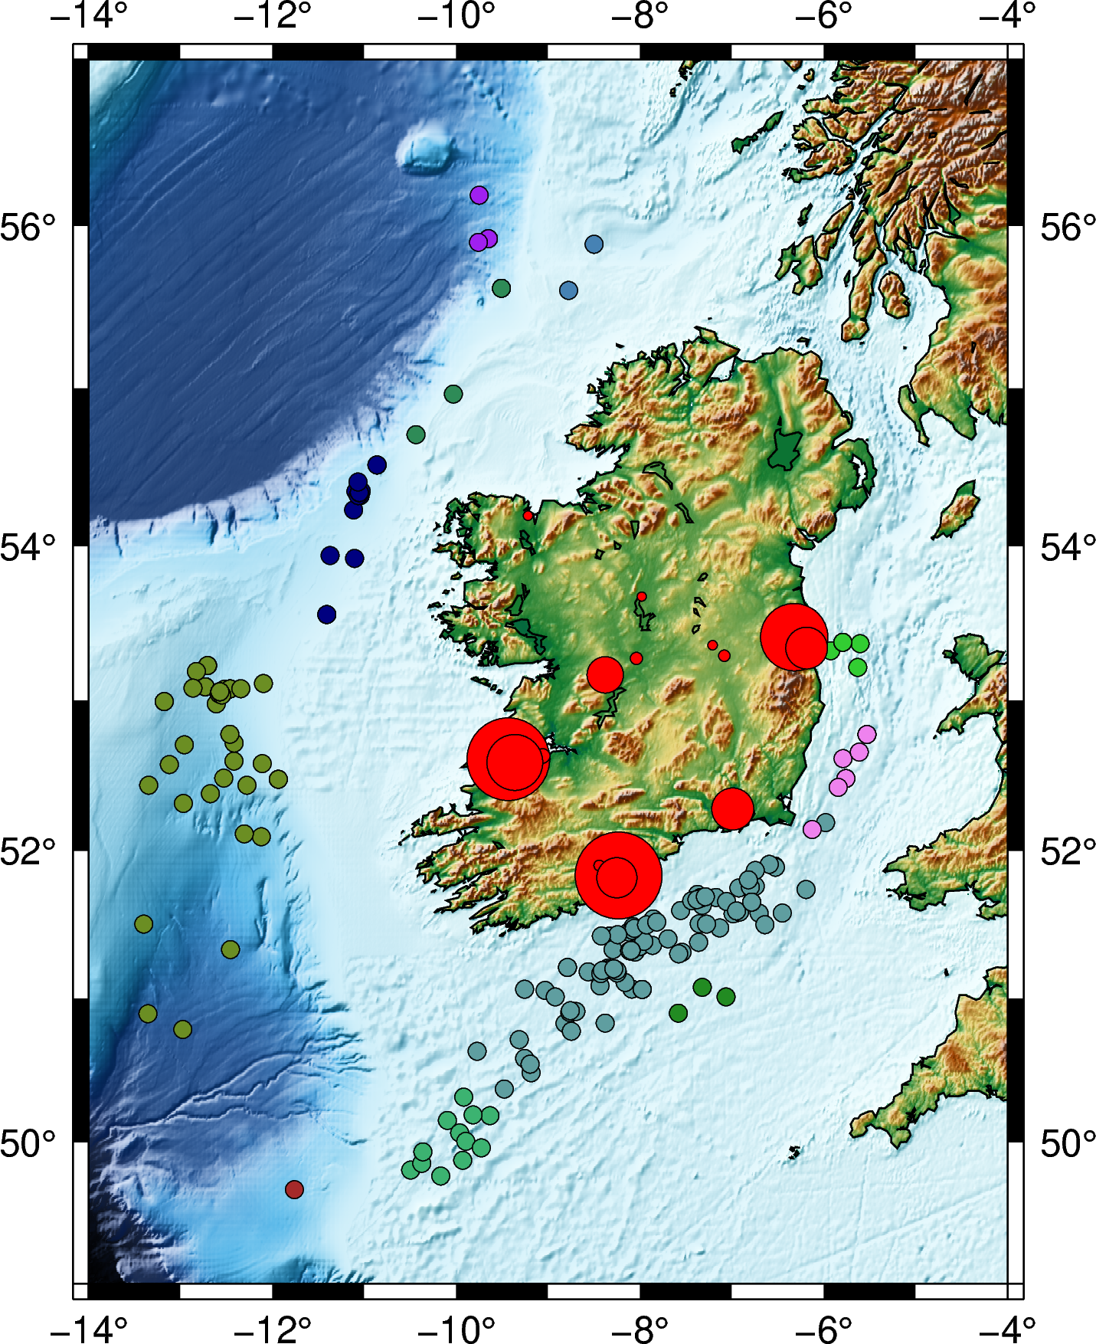
Carbon Capture and Storage in Ireland
Carbon Capture and Storage (CCS) is considered a key technology to combat climate change.
The sedimentary Celtic Sea basin offshore in Ireland (Fig. 1) hosts large potential for CO2 storage.
This could potentially contribute to the achievement of EU carbon reduction targets.
Figure 1. Wells drilled in the Irish offshore (each colour represents a different sedimentary basin) and main onshore CO2 sources.

Slide 3
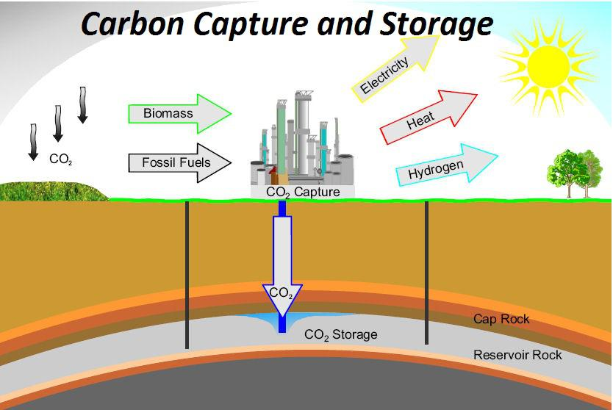
CO2 Storage
Involves first capturing CO2, pressurising it to bring it to its liquid state and transport it through pipelines or vessels to the storage facility
The storage facility involves one or more wells reaching depths > 1000 m
A trap (a geological structure that contains the fluid)
A reservoir (porous rock in which the fluid is stored), and
A seal (impermeable rock that prevents the CO2 to escape to the surface)

Slide 4
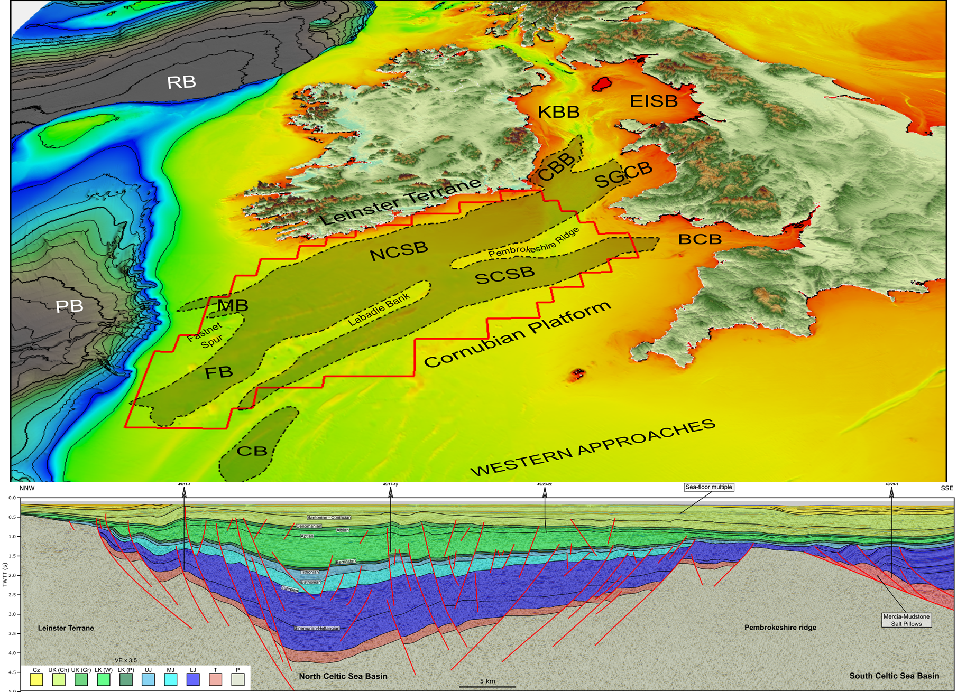
CO2 Storage in the Celtic Sea
Researchers at iCRAG are investigating the CO2 storage potential of the Celtic Sea basin rock structure (Fig. 2) using Ireland’s hydrocarbon (oil & gas) exploration database.
The relatively shallow water depths (+/-100 m, Fig. 2), the presence of proven seal and reservoir units and its proximity to large CO2 sources onshore, makes the Celtic Sea basin an ideal location for CO2 storage projects.
Figure 2. A) Bathymetric map of offshore Ireland showing the location of the Celtic sea Basins

Slide 6
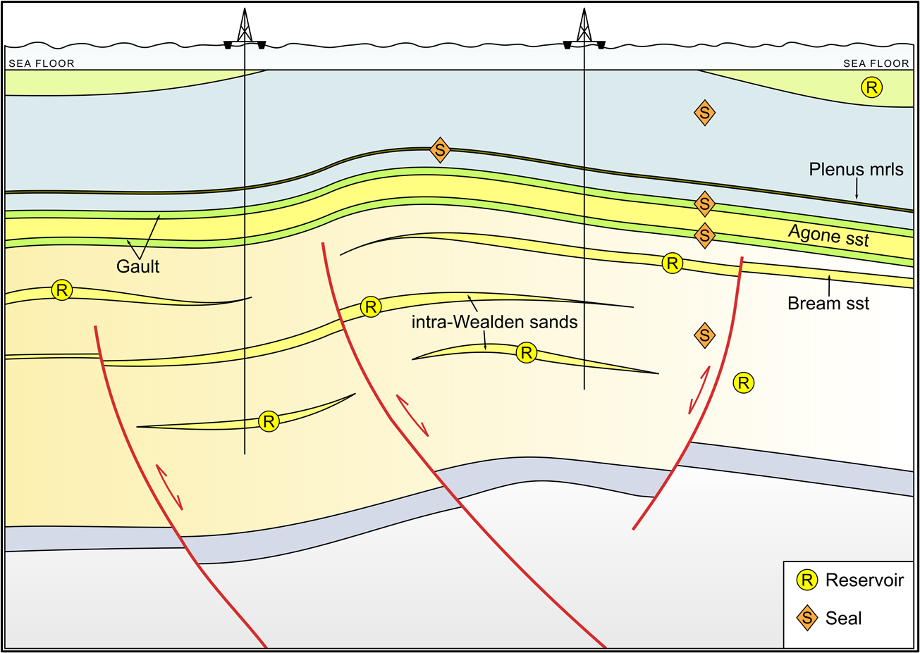
The CO2 Storage Elements
During this study the CO2 storage capacity of the Celtic Sea basin has been evaluated.
96 locations have been mapped
The elements being investigated include the main trap, a seal (S) made up of a thick layer of Cretaceous chalk and reservoir units (R).
Figure 3. The Upper Cretaceous CO2 storage play in the Celtic Sea.
Notes:
Explanation needed for inversion structures

Slide 7
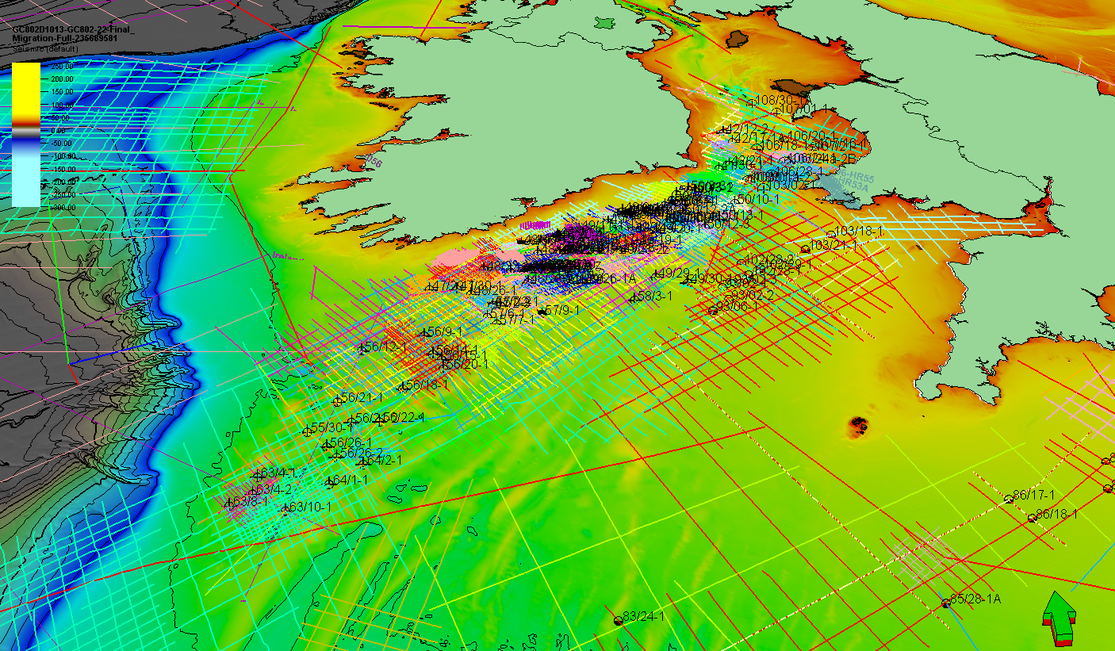
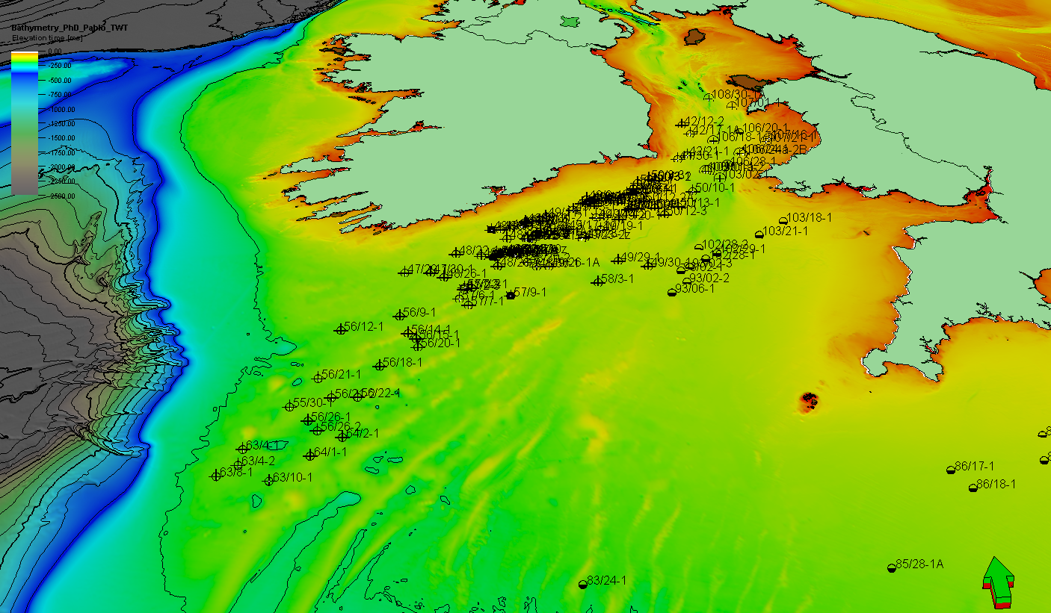
Geological Knowledge
Seismic (left) and borehole (right) database in the Celtic Sea. The yellow-green colour = 100 - 125 m of water depth.
Geological knowledge is critical to predict the amount of energy that can be stored, and develop the storage site
In Ireland we have access to subsurface rock information from 50 years of hydrocarbon exploration:
Wells: Direct access to the rocks, but the information is spatially restricted
Seismic: Regional access to the rocks, we can see faults, folds, gross thickness of beds, but the scale of observation is too coarse (no direct access to rocks, beds thinner than 30 m are not imaged.)

Slide 8
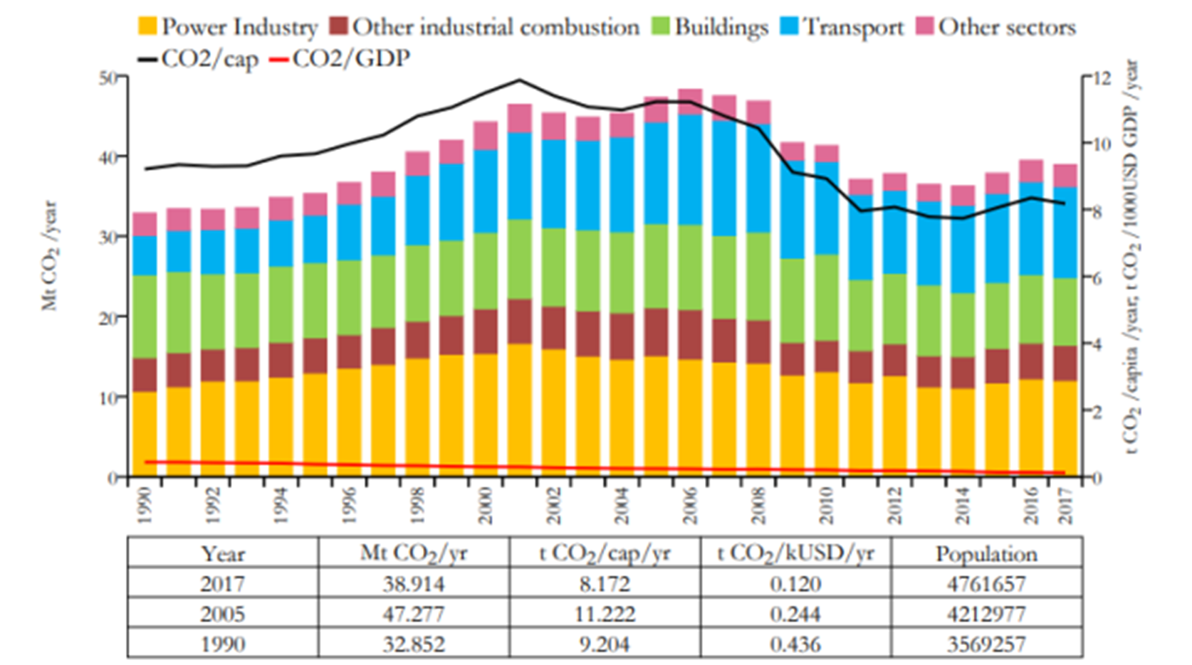
CO2 Emissions in Ireland by Sector

Slide 9
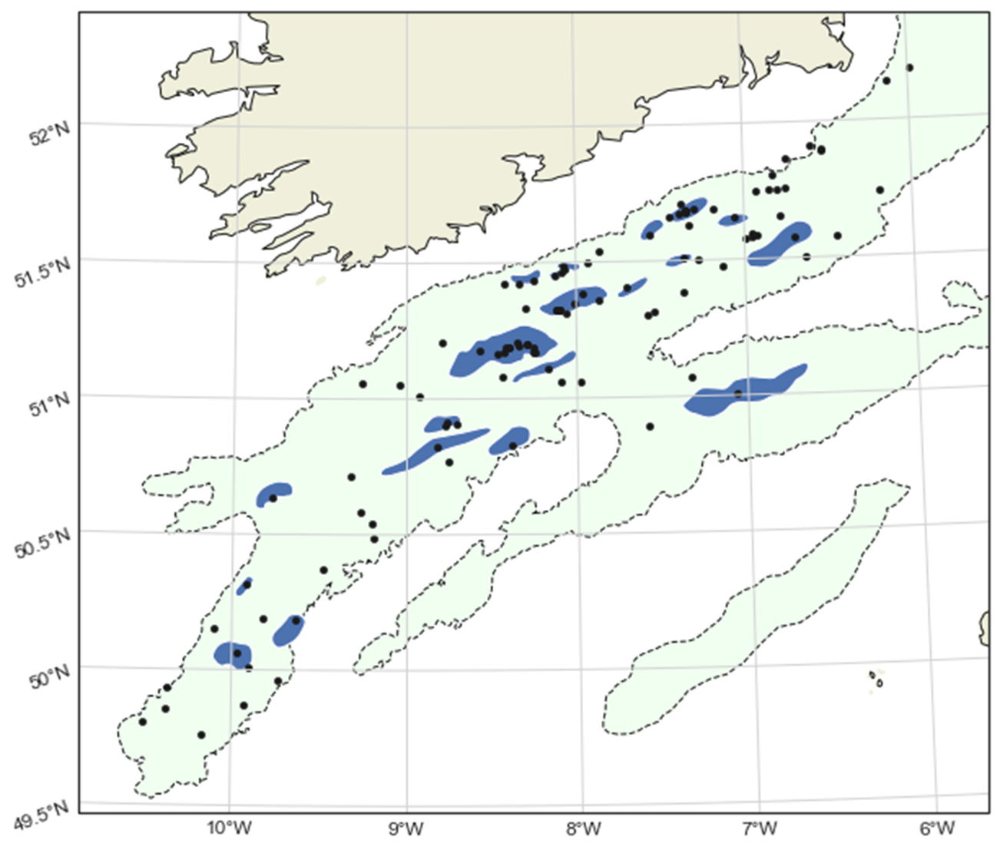
Preliminary results
The estimated capacity (17,611 Mt CO2) far exceeds Ireland’s annual emissions (ca 35 Mt CO2).
Additional capacity by undrilled inversion structures and pre-Cretaceous plays is currently been assessed.
Future work will focus on evaluating undrilled structures and assess its Hydrogen storage potential.
Figure 10. Map showing the selected of inversion structures for calculating the theoretical CO2 storage capacity.

Slide 10
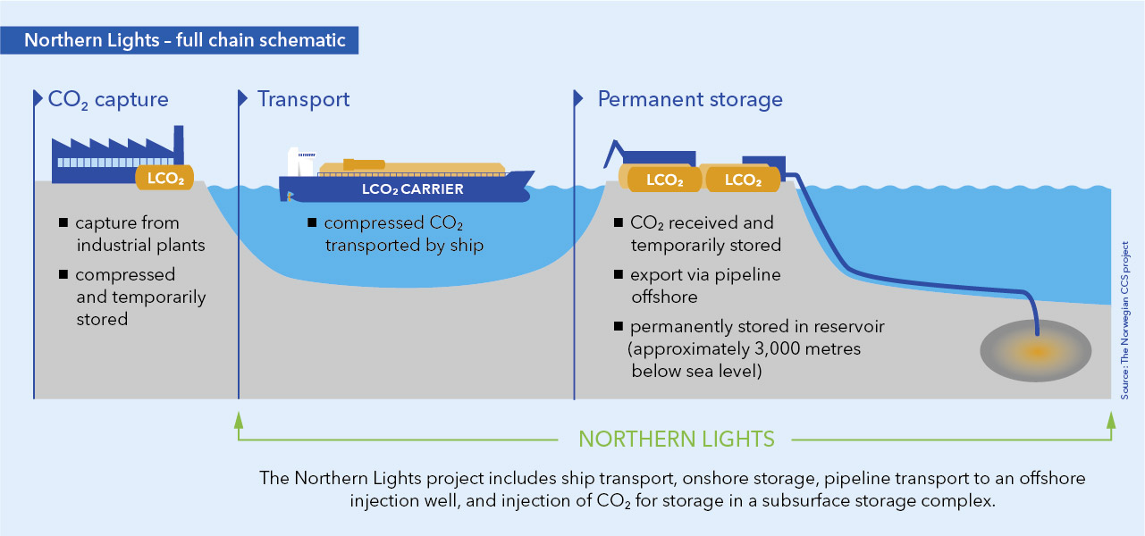
Transport of CO2 from source to storage sites
Gas Pipeline (under pressure)
Road (Motorway network)
Rail Network
Shipping (Cork Ports)
Map of the gas pipelines in Ireland

Slide 11
Potential Costs of Infrastructure
Capture and transport: gas compressors at CO2 source points, and pipelines connecting sources with offshore storage sites
Storage: drilling offshore wells and platform linked to the wells with equipment (compressors, pumps, etc) to conduct storage operations. As a reference value, the cost of drilling the most recent wells in offshore Ireland ranges between 30 – 50 million euros
After storage infrastructures are built, potential costs involve the process of collection (includes separating CO2 from other products and the process of transport and storage)

Slide 12
Acknowledgements
Thanks to Pablo Rodríguez-Salgado, iCRAG

